Slide 1
Low Power Design Methodology and Design Flow
Adopted From LOW POWER DESIGN ESSENTIALS - JAN M. RABAEY

Slide 2
Low-Power Design Methodology - Motivations
Minimize power
  Reduce power in various modes of device operation
  Dynamic power, leakage power, or total power
Minimize time
  Reduce power quickly
    Complete the design in as little time as possible
  Prevent downstream issues caused by LPD techniques
    Avoid complicating timing and functional verification
Minimize effort
  Reduce power efficiently
    Complete the design with as few resources as possible
  Prevent downstream issues caused by LPD techniques
    Avoid complicating timing and functional verification

Slide 3
Methodology Issues
Power Characterization and Modeling
  How to generate macro-model power data?
  Model accuracy
Power Analysis
  When to analyze?
  Which modes to analyze?
  How to use the data?
Power Reduction
  Logical modes of operation
    For which modes should power be reduced?
  Dynamic power versus leakage power
  Physical design implications
  Functional and timing verification
  Return on Investment
    How much power is reduced for the extra effort? Extra logic? Extra area?
Power Integrity
  Peak instantaneous power
  Electromigration
  Impact on timing

Slide 4
Some Methodology Reflections
Generate required models to support chosen methodology
Analyze power early and often
Employ (only) as many LPD techniques as needed to reach the power spec
  Some techniques are used at only 1 abstraction level; others are used at several
    Clock Gating: multiple levels
    Timing slack redistribution: only physical level
Methodology particulars dependent upon choice of techniques
  Power gating versus Clock gating
    Very different methodologies
No free lunch
  Most LPD techniques complicate the design flow
  Methodology must avoid or mitigate the complications

Slide 5
Power Characterization and Modeling
Objective: Build models to support low power design methodology
  Power consumption models
  Current waveform models
  Voltage-sensitive timing models
Issues
  Model formats, structures, and complexity
    Example: Liberty-power
  Run times
  Accuracy
[Ref: Liberty]

Slide 6
Power Characterization and Modeling
Process
Model
Spice
Netlists
Library
Params
Model
Templates
V_{dd}
Power Characterization
(using a circuit or power simulator)
I_{L}
Characterization
Database
(raw power data)
I_{sc}
C_{L}
I_{leakage}
Power Modeler
Power
Models
[Ref: J. Frenkil, Kluwer’02]

Slide 7
Generalized Low-Power Design Flow
Design Phase Low Power Design Activities
System-Level Design
Explore architectures and algorithms for power efficiency
Map functions to sw and/or hw blocks for power efficiency
Choose voltages and frequencies
Evaluate power consumption for different operational modes
Generate budgets for power, performance, area
RTL Design
Generate RTL to match system-level model
Select IP blocks
Analyze and optimize power at module level and chip level
Analyze power implications of test features
Check power against budget for various modes
Implementation
Synthesize RTL to gates using power optimizations
Floorplan, place and route design
Optimize dynamic and leakage power
Verify power budgets and power delivery

Slide 8
Power-Analysis Methodology
Motivation
  Determine if the design will meet the power spec ASAP
  Identify opportunities for power reduction, if needed
Method
  Set up regular, automatic power analysis runs (nightly, weekly)
  Run regular power analysis regressions as soon as a simulation environment is ready
    Initially can re-use functional verification tests
    Add targeted mode- and module-specific tests to increase coverage
  Compare analysis results against design spec
    Check against spec for different operational modes
  Compare analysis results against previous analysis results
    Identify power mistakes - changes / fixes resulting in increased power
  Identify opportunities for power reduction

Slide 9
Power Analysis Methodology Issues
Development phases
  System
    Description available early in the design cycle
    Least accurate but fastest turn times
  Design
    Most common design representation
    Easy to identify power savings opportunities
      Power results can be associated with specific lines of code
  Implementation
    Gate level design available late in the design cycle
    Slowest turn times (due to lengthy gate level simulations) but most accurate results
    Difficult to interpret results for identifying power saving opportunities
      can’t see the forest for the trees
Availability of data
  When are simulation traces available?
  When is parasitic data available?

Slide 10
System-Phase Analysis Methodology
ESL
stimulus
IP sim
models
ESL
Code
IP power
models
Env.
Data
Tech.
Data
ESL Simulation
ESL Synthesis
RTL
Code
Trans.
traces
RTL Power Analysis
Power
Reports

Slide 11
Design-Phase Analysis Methodology
mode 1
RTL
Stimulus
mode 2
RTL
Stimulus
RTL
Design
IP power
models
Env.
Data
Tech.
Data
mode n
RTL
Stimulus
RTL Simulation
mode 1
Activity
Data
RTL Power Analysis
mode 2
Activity
Data
mode n
Activity
Data
Power
Reports
Power
Reports
Power
Reports

Slide 12
Implementation-Phase Analysis
mode 1
RTL
Stimulus
mode 2
IP power
models
RTL
Stimulus
RTL
Design
Env.
Data
Tech.
Data
mode n
RTL
Stimulus
RTL Simulation
RTL Synthesis
mode 1
gate
netlist
Activity
Data
mode 2
Gate level
Power Analysis
Activity
Data
mode n
Activity
Data
Power
Reports
Power
Reports
Power
Reports

Slide 13
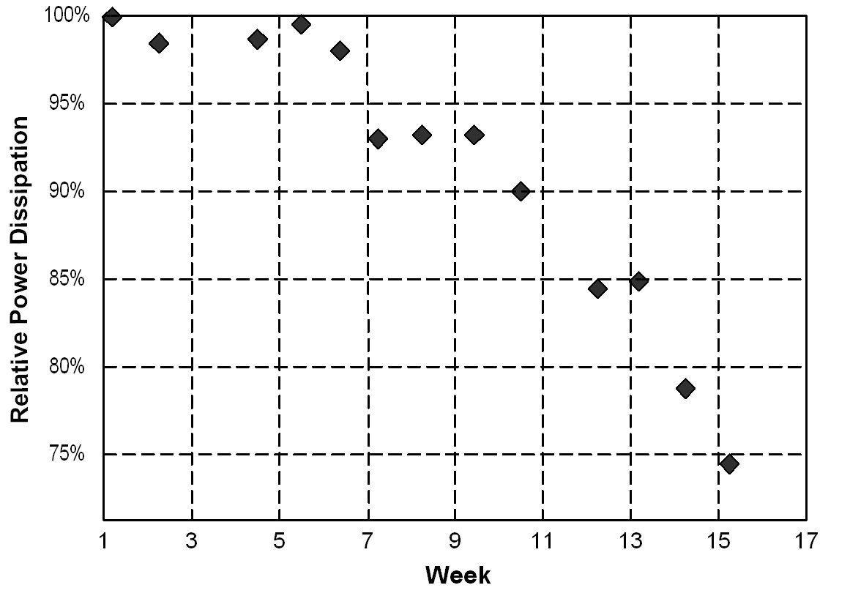
Power Analysis Over Project Duration
Weekly power regression results
[Courtesy: Tensilica, Inc.]

Slide 14
System-Phase Low Power Design
Primary objectives: minimize f_{eff} and V_{DD}
Modes
  Modes enable power to track workload
  Software programmable; set / controlled by OS
    Hardware component needed to facilitate control
    Software timers and protocols needed to determine when to change modes and how long to stay in a mode
Parallelism and Pipelining
  V_{DD} can be reduced, since equivalent throughput can be achieved with slower speeds
Challenges
  Evaluating different alternatives

Slide 15
Power Down Modes - Example
Modes control clock frequency, V_{DD}, or both
  Active mode: maximum power consumption
    Full clock frequency at max V_{DD}
  Doze mode: ~10X power reduction from active mode
    Core clock stopped
  Nap mode: ~ 50% power reduction from doze mode
    V_{DD} reduced, PLL & bus snooping stopped
  Sleep mode: ~10X power reduction from nap mode
    All clocks stopped, core V_{DD} shut-off
Issues and Tradeoffs
  Determining appropriate modes and appropriate controls
  Trading-off power reduction to wake-up time
[Ref: S. Gary, D&T’94]

Slide 16
Parallelism and Pipelining - Example
Concept: maintain performance with reduced V_{DD}
  Total area increases but each datapath works less in each cycle
    V_{DD} can be reduced such that the work requires the full cycle time
    Cycle time remains the same, but with reduced V_{DD}
  Pipelining a datapath
    Power can be reduced by 50% or more
    Modest area overhead due to additional registers
  Paralleling a datapath
    Power can be reduced by 50% or more
    Significant area overhead due to paralleled logic
  Multiple CPU cores
    Enables multi-threaded performance gains with a constrained V_{DD}
Issues and Tradeoffs
  Application: can it be paralleled or threaded?
  Area: what is the area increase for the power reduction?
  Latency: how much can be tolerated?
[Ref: A. Chandrakasan, JSSC’92]

Slide 17
System-Phase Low-Power Design Flow
Create design in C / C++
Simulate C / C++ under typical work loads
Transmitter Design (IFFT Block) | Area (mm2) | Symbol Latency (cycles) | Throughput (cycle/symbol) | Min. Freq to Achieve Req. Rate Avg. Power | Avg. Power (mW)
Combinational | 4.91 | 10 | 4 | 1.0 MHz | 3.99
Pipelined | 5.25 | 12 | 4 | 1.0 MHz | 4.92
Folded (16 Bfly4s) | 3.97 | 12 | 4 | 1.0 MHz | 7.27
Folded (8 Bfly4s) | 3.69 | 15 | 6 | 1.5 MHz | 10.9
Folded (4 Bfly4s) | 2.45 | 21 | 12 | 3.0 MHz | 14.4
Folded (2 Bfly4s) | 1.84 | 33 | 24 | 6.0 MHz | 21.1
Folded (1 Bfly4) | 1.52 | 57 | 48 | 12.0 MHz | 34.6
Create / synthesize different versions
Evaluate power of each version
Example: Exploration of IFFT block for 802.11a transmitter using BlueSpec SystemVerilog
[Ref: N. Dave, Memocode’06]
Choose lowest power version

Slide 18
Design-Phase Low Power Design
Primary objective: minimize f_{eff}
Clock gating
  Reduces / inhibits unnecessary clocking
    Registers need not be clocked if data input hasn’t changed
Data gating
  Prevents nets from toggling when results won’t be used
    Reduces wasted operations
Memory system design
  Reduces the activity internal to a memory
    Cost (power) of each access is minimized

Slide 19



Clock Gating
Power is reduced by two mechanisms
  Clock net toggles less frequently, reducing f_{eff}
  Registers’ internal clock buffering switches less often
FSM
d
q
dout
enF
din
en
qn
clk
clk
Execution
Unit
enE
din
d
q
dout
Memory
Control
en
qn
enM
clk
clk
clk
Local Gating Global Gating

Slide 20
Clock Gating Insertion
Local clock gating: 3 methods
  Logic synthesizer finds and implements local gating opportunities
  RTL code explicitly specifies clock gating
  Clock gating cell explicitly instantiated in RTL
Global clock gating: 2 methods
  RTL code explicitly specifies clock gating
  Clock gating cell explicitly instantiated in RTL

Slide 21
Clock Gating Verilog Code
Conventional RTL Code
//always clock the register
always @ (posedge clk) begin // form the flip-flop
if (enable) q = din;
end
Low Power Clock Gated RTL Code
//only clock the register when enable is true
assign gclk = enable && clk; // gate the clock
always @ (posedge gclk) begin // form the flip-flop
q = din;
end
Instantiated Clock Gating Cell
//instantiate a clock gating cell from the target library
clkgx1 i1 .en(enable), .cp(clk), .gclk_out(gclk);
always @ (posedge gclk) begin // form the flip-flop
q = din;
end

Slide 22

Clock Gating: Glitch Free Verilog
Add a Latch to Prevent Clock Glitching
Clock Gating Code with Glitch Prevention Latch
always @ (enable or clk) begin
if !clk then en_out = enable // build latch
end
assign gclk = en_out && clk; // gate the clock
L1
enable
d
q
en_out
LATCH
gn
G1
clk
gclk

Slide 23
Data Gating
Objective
  Reduce wasted operations => reduce f_{eff}
Example
  Multiplier whose inputs change
  every cycle, whose output
  conditionally feeds an ALU
Low Power Version
  Inputs are prevented from
  rippling through multiplier
  if multiplier output is not
  selected
X
X

Slide 24
Data Gating Insertion
Two insertion methods
  Logic synthesizer finds and implements data gating opportunities
  RTL code explicitly specifies data gating
    Some opportunities cannot be found by synthesizers
Issues
  Extra logic in data path slows timing
  Additional area due to gating cells

Slide 25
Data Gating Verilog Code: Operand Isolation
Conventional Code
assign muxout = sel ? A : A*B ; // build mux
Low Power Code
assign multinA = sel & A ; // build and gate
assign multinB = sel & B ; // build and gate
assign muxout = sel ? A : multinA*multinB ;
B
X
muxout
A
sel
B
X
muxout
A
sel

Slide 26
Memory System Design
Primary objectives: minimize f_{eff} and C_{eff}
  Reduce number of accesses or (power) cost of an access
Power Reduction Methods
  Memory banking / splitting
  Minimization of number of memory accesses
Challenges and Tradeoffs
  Dependency upon access patterns
  Placement and routing

Slide 27


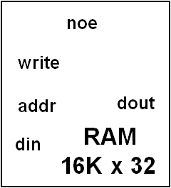
Split Memory Access
16K x 32
RAM
din
32
addr
dout
write
15
addr[14:0]
noe
pre_addr
d
q
addr[14:1]
dout
clock
32
addr[0]

Slide 28
Implementation Phase Low Power Design
Primary objective: minimize power consumed by individual instances
Low power synthesis
  Dynamic power reduction via local clock gating insertion, pin-swapping
Slack redistribution
  Reduces dynamic and/or leakage power
Power gating
  Largest reductions in leakage power
Multiple supply voltages
  The implementation of earlier choices
Power integrity design
  Ensures adequate and reliable power delivery to logic

Slide 29
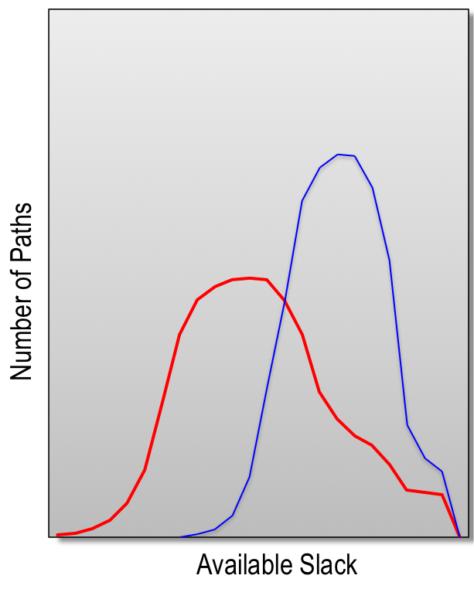
Slack Redistribution
Objective
  Reduce dynamic power or leakage power or both by trading-off positive timing slack
  Physical level optimization
    Best optimized post-route
    Must be noise aware
Dynamic power reduction by cell resizing
  Cells along non-speed critical path resized
    Usually downsized, sometimes upsized
  Power reduction of 10% to 15%
Leakage power reduction by V_{TH} assignment
  Cells along non-speed critical path set to High V_{TH}
  Leakage reduction of 20% to 60%
Dynamic & leakage power can be optimized independently or together
Post-optimized
Pre-optimized
[Ref: Q. Wang, TCAD’02]

Slide 30
Dynamic Power Optimization: Cell Resizing
Positive Slack Trade-off for Reduced Dynamic Power
  Objective: reduce dynamic power where speed is not needed
  Optimization performed post-route for optimum results
  Cells along paths with positive slack replaced with lower drive cells
    Switching currents, input capacitances, and area are all reduced
    Incremental re-route required – new cells may have different footprints from the previous cells
2x
1x
2x
1x
2x
2x
2x
2x
2x
2x
2x
2x
2x
2x
2x
2x
High speed, high power
Reduced speed, lower power

Slide 31
Leakage Power Optimization: Multi-V_{TH}
Trade-off Positive Slack for Reduced Leakage Power
  Objective: reduce leakage power where speed is not needed
  Optimization performed post-route for optimum results
  Cells along paths with positive slack replaced with High-V_{TH} cells
    Leakage currents reduced where timing margins permits
    Re-route not required – new cells have same footprint as previous cells
L
H
L
H
L
L
L
L
L
L
L
L
L
L
L
L
High speed, high leakage
Reduced speed, low leakage

Slide 32
Slack Redistribution Flows
Place & Route
Place & Route
Check Timing
Check Timing
Fix Timing
OK
Fix Timing
OK
n
n
y
y
Check Noise
OR
Check Noise
Fix Noise
OK
Fix Noise
(timing aware)
OK
n
n
y
y
Check Pwr
Check Pwr
Reduce Pwr
OK
Reduce Power
(timing and
noise aware)
OK
n
n
y
y

Slide 33
Slack Redistribution: Trade-offs and Issues
Yield
  Slack redistribution effectively turns non-critical paths into critical or semi-critical paths
    Increased sensitivity to process variation and speed faults
Libraries
  Cell resizing needs a fine granularity of drive strengths for best optimization results => more cells in the library
  Multi-V_{TH} requires an additional library for each additional V_{TH}
Iterative loops
  Timing and noise must be re-verified after each optimization
    Both optimizations increase noise and glitch sensitivities
Done late in the design process
  Difficult to predict in advance how much power will be saved
    Very dependent upon design characteristics

Slide 34
Power Gating
Objective
  Reduce leakage currents by inserting a switch transistor (usually high V_{TH}) into the logic stack (usually low V_{TH})
    Switch transistors change the bias points (V_{SB}) of the logic transistors
Most effective for systems with standby operational modes
  1 to 3 orders of magnitude leakage reduction possible
  But switches add many complications
Vdd
Logic
Cell
Vdd
Logic
Cell
Virtual
Ground
sleep
Switch
Cell

Slide 35
Power-Gating Physical Design
Switch placement
  In each cell?
    Very large area overhead, but placement and routing is easy
  Grid of switches?
    Area efficient, but a third global rail must be routed
  Ring of switches?
    Useful for hard layout blocks, but area overhead can be significant
Global Supply
Virtual Grounds
Module
Virtual
Supply
Switch Integrated
Within Each Cell
Switch
Cells
Switch Cell
Switch-in-cell
Grid of Switches
Ring of Switches
[Ref: S. Kosonocky, ISLPED’01]

Slide 36
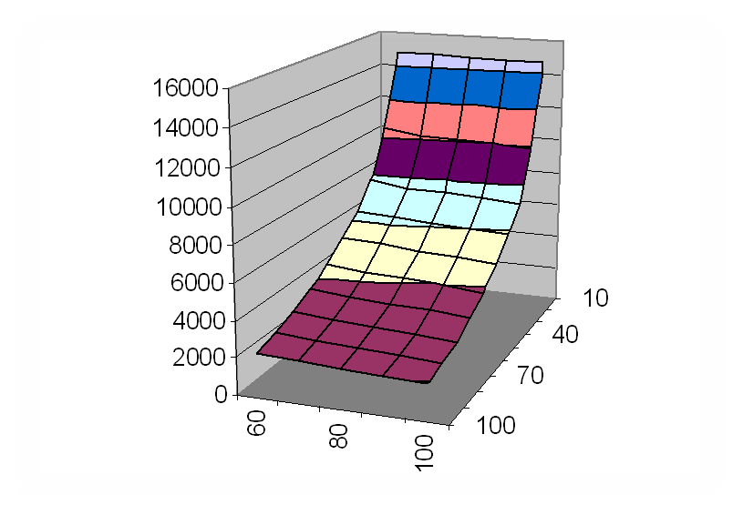
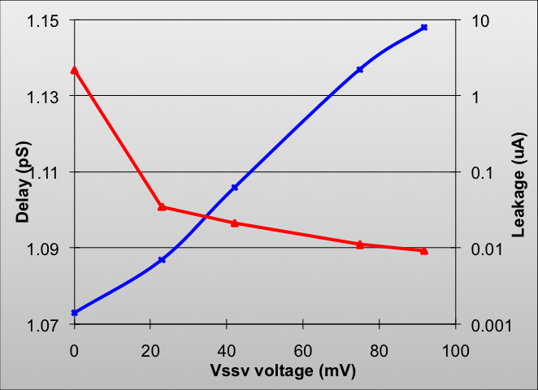
Power Gating Switch Sizing
Tradeoff between area, performance, leakage
  Larger switches => less voltage drop, larger leakage, more area
  Smaller switches => larger voltage drop, less leakage, less area
Switch
Cell
Area
(µ²)
I_{LKG}
t_{D}
V_{vg_max} (mV)
L_{vg_max} (µ)
[Ref: J. Frenkil, Springer’07]

Slide 37
Power Gating: Additional Issues
Library design: special cells are needed
  Switches, isolation cells, state retention flip-flops (SRFFs)
Headers or Footers?
  Headers better for gate leakage reduction, but ~ 2X larger
Which modules, and how many, to power gate?
  Sleep control signal must be available, or must be created
State retention: which registers must retain state?
  Large area overhead for using SRFFs
Floating signal prevention
  Power-gate outputs that drive always-on blocks must not float
Rush currents and wakeup time
  Rush currents must settle quickly and not disrupt circuit operation
Delay effects and timing verification
  Switches affect source voltages which affect delays
Power-up & power-down sequencing
  Controller must be designed and sequencing verified

Slide 38
Power Gating Flow
Design power gating library cells
Determine floorplan
Determine which blocks to power gate
Power gating aware placement
Determine state retention mechanism
Clock tree synthesis
Determine rush current control scheme
Route
Design power gating controller
Verify virtual rail electrical characteristics
Power gating aware synthesis
Verify timing

Slide 39
Multi-VDD
Objective
  Reduce dynamic power by reducing the V_{DD}² term
    Higher supply voltage used for speed-critical logic
    Lower supply voltage used for non speed-critical logic
Example
  Memory V_{DD} = 1.2 V
  Logic V_{DD} = 1.0 V
  Logic dynamic power
  savings = 30%

Slide 40
Multi-VDD Issues
Partitioning
  Which blocks and modules should use with voltages?
  Physical and logical hierarchies should match as much as possible
Voltages
  Voltages should be as low as possible to minimize CV_{DD}²f
  Voltages must be high enough to meet timing specs
Level shifters
  Needed (generally) to buffer signals crossing islands
    May be omitted if voltage differences are small, ~ 100mV
  Added delays must be considered
Physical design
  Multiple V_{DD} rails must be considered during floorplanning
Timing verification
  Signoff timing verification must be performed for all corner cases across voltage islands.
  For example, for 2 voltage islands V_{hi}, V_{lo}
    Number of timing verification corners doubles

Slide 41
Multi-VDD Flow
Determine which blocks run at which Vdd
Multi-voltage
synthesis
Determine floor plan
Multi-voltage placement
Clock tree synthesis
Route
Verify timing

Slide 42
Power Integrity Methodologies
Motivation
  Ensure that the power delivery network will not adversely affect the intended performance of the IC
    Functional operation
    Performance – speed and power
    Reliability
Method
  Analyze specific voltage drop parameters
    Effective grid resistances
    Static voltage drop
    Dynamic voltage drop
    Electromigration
  Analyze impact of voltage drop upon timing and noise

Slide 43
Power-Integrity Verification Flow
Floorplan, Power Grid Distribution
Placement, Power
Routing
Check Effective Resistances
Stimulus Selection
(Vectorless or simulation based)
Static Voltage Drop
Analysis
Extracted
Grid RLC
Dynamic Voltage Drop
Analysis & Optimization
Voltage Drop & EM analyses
(Compute time varying currents)
Package
Model
Routing
Instance
Currents
Dynamic Voltage Drop
& EM Analysis
Voltage Drop optimization
(Spread peak currents,
insert & optimize decaps)
Decap
Models
Dynamic Voltage Drop
Optimization
Voltage Aware
Timing & SI Analysis
Voltage aware STA/SI
(Compute voltage drop effects
on timing & SI)
Power Grid Sign-off

Slide 44
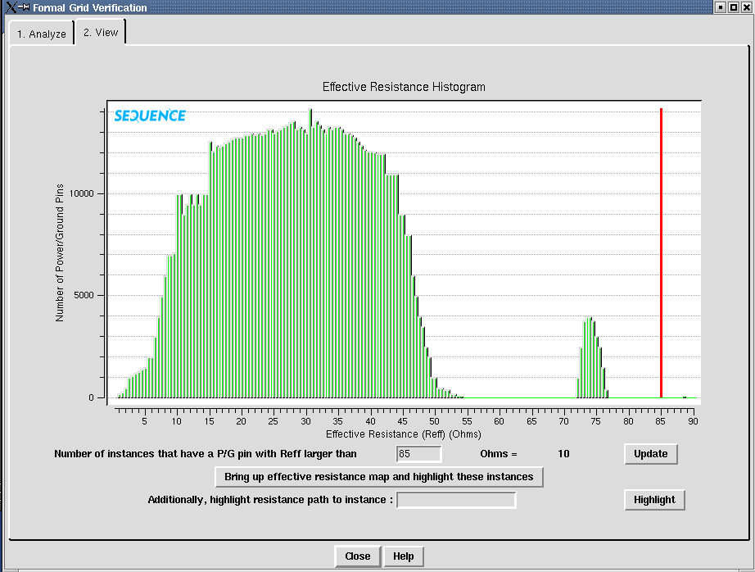
Power Integrity: Effective Resistance Check
Motivation
  Verify connectivity of all
  circuit elements to the
  power grid
    Are all elements
    connected?
    Are all elements
    connected to the grid
    with a low resistance?
Method
  Extract power grid to
  obtain R
  Isolate and analyze R
  in the equation
  V(t) = I(t)*R + C*dv/dt *R + L*di/dt
Resistance Histogram
Well formed distribution
of resistances indicates
well-connected instances
Unexpected outliers
indicate poorly
connected (high R)
Instances.

Slide 45
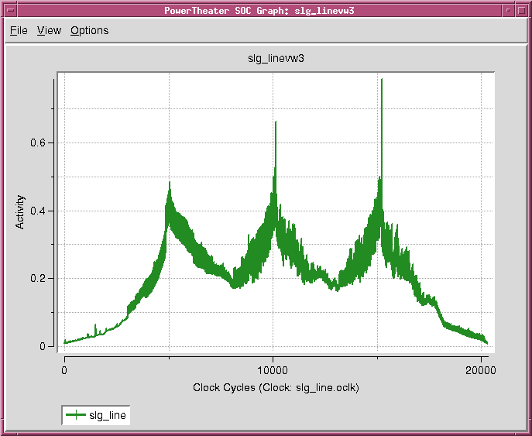
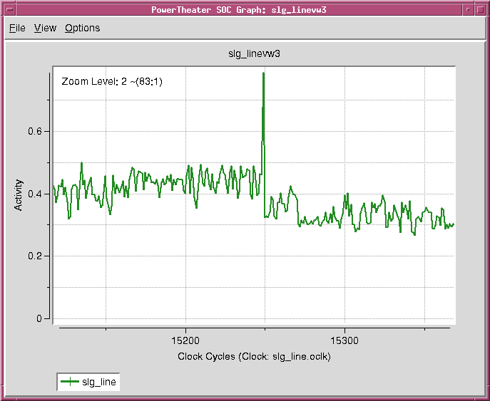
Power Integrity: Stimulus Selection

Slide 46
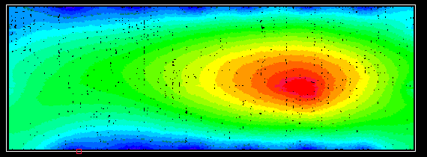
Power Integrity: Static Voltage Drop
Motivation
  Verify first order voltage drop
    Is grid sufficient to handle average current flows?
    Static voltage drop should only be a few % of the supply voltage
Method
  Extract power grid to
  obtain R
  Select stimulus
  Compute time averaged power consumption for a typical operation to obtain I
  Compute: V = IR
    Non time-varying
0% drop
2.5% drop
5% drop
7.5% drop
10% drop
Typical static voltage drop bulls-eye of an appropriately constructed power grid.
But 10% static voltage drop is very high.

Slide 47
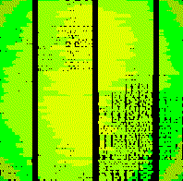
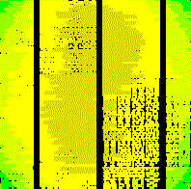
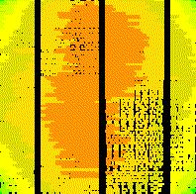
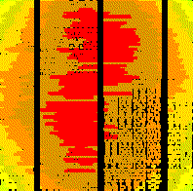
Power Integrity: Dynamic Voltage Drop
Motivation
  Verify dynamic voltage drop
    Are current and voltage transients within spec?
    Can chip function as expected in external RLC environment?
Method
  Extract power grid to obtain on-chip R and C
  Include RLC model of the package and bond wires
  Select stimulus
  Compute time varying power for specific operation to obtain I(t)
  Compute V(t) = I(t)*R + C*dv/dt*R + L*di/dt
Timestep 1 @ 20 ps
Timestep 2 @ 40 ps
Timestep 3 @ 60 ps
Timestep 4 @ 80 ps

Slide 48
Voltage Drop Mitigation with Decoupling Caps
Explicit decoupling caps can be added to the power delivery network
  Effectiveness highly dependent upon proximity to supply noise aggressor
DECAP
R_{pkg}
L_{pkg}
On-chip
R_{Vdd}
V_{DD}
C_{Vdd}
C_{pkg}
Package +
bond-wire
R_{decap}
C_{n-well}
R_{on}
C_{decap}
K_{mutual}
C_{coupling}
C_{cell}
R_{signal}
R_{decap}
C_{p-well}
R_{on}
C_{signal}
R_{pkg}
L_{pkg}
R_{Vss}
C_{Vss}
V_{SS}
C_{pkg}

Slide 49
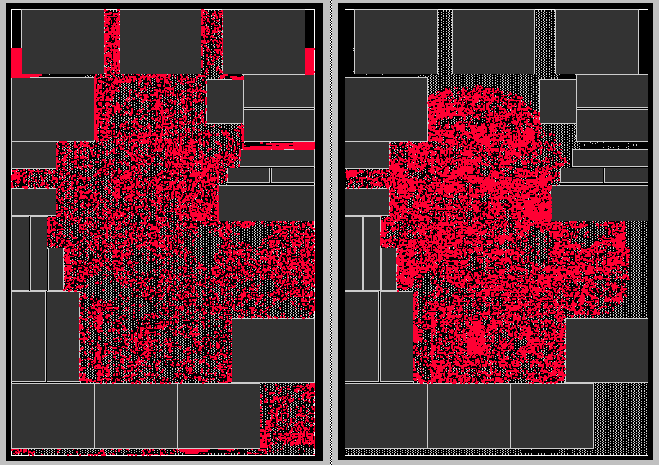
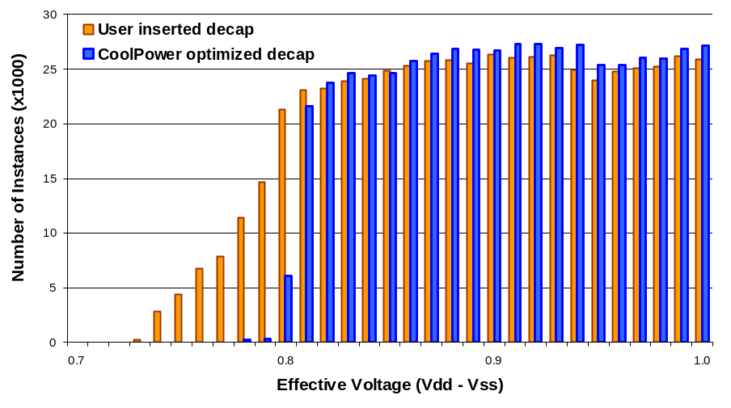
Decoupling Cap Effectiveness
47 mV improvement after
decap placement optimization
Decaps placement based upon available space
Decaps optimized placement based upon dynamic voltage drop

Slide 50
Dynamic Voltage Drop Impact
Timing analysis without voltage drop finds no negative slack paths
Timing analysis with voltage drop uncovers numerous timing violations
Without Voltage Drop
With Voltage Drop
4500
4000
3500
3000
2500
Number of paths
90000
2000
80000
1500
70000
1000
60000
500
Number of paths
50000
0
40000
-2
-1.5
-1
-0.5
0
0.5
30000
20000
10000
0
-2
-1
0
1
2
3
4
5
6
7
8
9
Slack(ns)
10
11
12
13
14
15

Slide 51
Summary - Low Power Methodology Review
Characterization and modeling for power
  Required for SoC cell based design flows
Power analysis
  Run early and often, during all design phases
Power reduction
  Multiple techniques and opportunities during all phases
  Most effective opportunities occur during the early design phases
Power integrity
  Voltage drop analysis is a critical verification step
  Consider the impact of voltage drop upon timing and noise

Slide 52
Some Useful References
Books and Book Chapters
A. Chandrakasan, R. Brodersen, Low Power Digital CMOS Design, Kluwer Academic Publishers, 1995.
D. Chinnery, K. Keutzer, Closing the Power Gap Between ASIC and Custom, Springer, 2007.
J. Frenkil, “Tools and Methodologies for Power Sensitive Design”, in Power Aware Design Methodologies, M. Pedram and J. Rabaey, Kluwer, 2002.
J. Frenkil and S. Venkatraman, “Power Gating Design Automation”, in [Chinnery, Springer’07].
M. Keating et al, Low Power Methodology Manual − For System-on-Chip Design, Springer, 2007.
C. Piguet, Ed., Low-Power Electronics Design, Ch. 38-42, CRC Press, 2005
Articles and Web Sites
Cadence Power Forward Initiative, http://www.cadence.com/partners/power_forward/index.aspx
A. Chandrakasan, S. Sheng, and R. W. Brodersen, "Low-power Digital CMOS Design," IEEE Journal of Solid State Circuits, pp. 473-484, April 1992.
N. Dave, M. Pellauer, S. Gerding, Arvind, “802.11a Transmitter: A Case Study in Microarchitectural Exploration”, MEMOCODE 2006.
S. Gary, P. Ippolito, G. Gerosa, C. Dietz, J. Eno, H., Sanchez, “PowerPC603, A Microprocessor for Portable Computers”, IEEE Design and Test of Computers, Volume 11, Issue 4, pp. 14-23, Winter 1994.
S. Kosonocky, et. al., “Enhanced multi-threshold (MTCMOS) circuits using variable well bias”, ISLPED Proceedings, pp. 165-169, 2001.
Liberty Modeling Standard, http://www.opensourceliberty.org/resources_ccs.html#1
Sequence PowerTheatre, http://www.sequencedesign.com/solutions/powertheater.php
Sequence CoolTime,
http://www.sequencedesign.com/solutions/coolproducts.php
Synopsys Galaxy Power Environment, http://www.synopsys.com/products/solutions/galaxy/power/power.html
Q. Wang and S. Vrudhula, “Algorithms for minimizing standby power in deep submicrometer, dual-Vt CMOS circuits,” IEEE Transactions on Computer-Aided Design of Integrated Circuits and Systems, Vol. 21, No. 3, pp 306–318, March 2002.

